Slide 1
Presentation to
Colorado Association of Ski Towns
October 23, 2015

Slide 2
WHO are we?

Slide 3
Who is “Building a Better Colorado”?
A non-partisan group of civic leaders statewide who’ve come together with a shared concern for our state’s future.
Hank Brown
frmr U.S. Senator
Gigi Dennis
frmr Secretary of State
Tim Foster
President, Colo Mesa Univ
Michael Hancock
Mayor of Denver
John Hickenlooper
Governor of Colorado
Rebecca Kourlis
frmr Supreme Court Justice
Phyllis Norris
Mayor of Grand Junction
Gale Norton
frmr U.S. Sec of the Interior
Tom Norton
frmr State Senator
Federico Pena
frmr Mayor of Denver
Bill Ritter
frmr Governor of Colorado
Roy Romer
frmr Governor of CO
Ken Salazar
frmr U.S. Sec of the Interior
Gail Schwartz
frmr State Senator
John Suthers
Mayor of Colorado Springs
Wellington Webb
frmr Mayor of Denver

Slide 4
WHAT are we doing?

Slide 5
WHAT are we doing?
We’re teeing up a conversation.
We’re concerned about what we see as a growing disconnect between citizens and their government, as evidenced by:
the increasing number of amendments to our constitution
the decreasing number of citizens who participate in our election process
the decreasing ability of our state government to meet the expectations of it’s citizens
We’re engaging Coloradans in this conversation.
We believe the pathway to a better Colorado lies in engaging citizens statewide in a constructive conversation about what THEY want their state to be.
We’re taking action.
We are committed to supporting implementation of consensus policy recommendations.

Slide 6
WHAT are we NOT doing?
We are NOT advocating for any particular policy recommendation. We want to hear YOUR opinion.

Slide 7
HOW are we going to “engage citizens”?

Slide 8

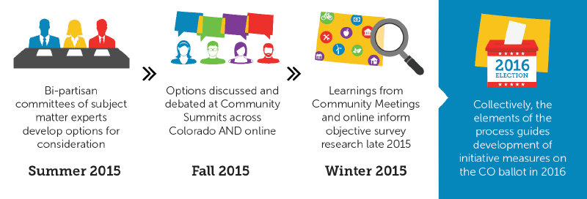
Engaging Coloradans in 3 Ways

Slide 9
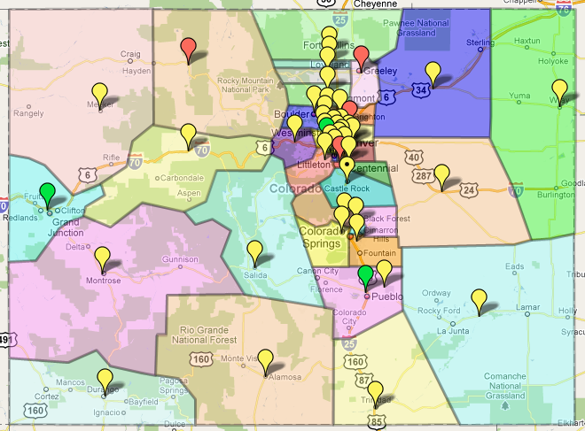
Targeting Civic Leaders in 40 Communities across Colorado

Slide 10
WHY these three issues?
WHAT is the problem?

Slide 11
What’s the problem with our INITIATIVE PROCESS?
Colorado has one of the most easily-amended state constitutions, and therefore we’ve seen more citizen initiatives than any state except CA and OR.

Slide 12
Number of Initiatives to Date by State
(Shaded areas of each bar denotes number of measures approved.)
Colorado
2
3
1
Source: Initiative & Referendum Institute
Notes:
12
12

Slide 13
State Initiative Trends
NOTE: These are NOT cumulative values.
Notes:
13
13

Slide 14
Easy Initiative Process = Cluttered Constitution
Because it’s just as easy for citizens to amend our state CONSTITUTION as it is to amend state LAWS, and
Because amendments to the constitution are much harder to change in the future than are amendments to state law (fixing problems in the constitution requires another vote of the people, whereas our elected legislature can fix problems in state law),
Initiative proponents (many of whom are out-of-state interests) are incentivized to pursue amendments to our CONSTITUTION rather than state LAWS, and this is creating an increasingly inflexible and conflicted framework for our state.

Slide 15
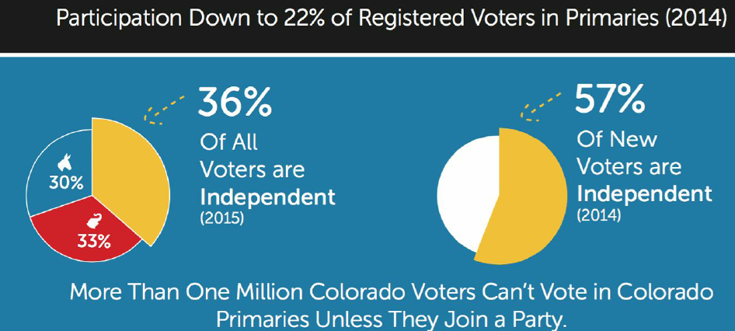
What’s the problem with our ELECTION PROCESS?
A decreasing # of voters are participating in primary elections.
Unaffiliated voters, which make up the largest and fastest growing block of Colorado’s electorate, can’t easily participate in this process for which they help pay.

Slide 16
What’s the problem with our FISCAL POLICY?
Colorado’s fiscal policy is unsustainable because of a combination of constitutional spending mandates and revenue limitations, and health care costs related to our aging population.
Notes:
We say that Colorado’s fiscal situation is unsustainable. Why are we saying this? The reasons that Colorado is in a tight spot financially can be demonstrated in a few words and graphs.
Bear with me as I take a very short tour through the state budget, changing demographics and the rules that combine to put us in this tight spot.

Slide 17
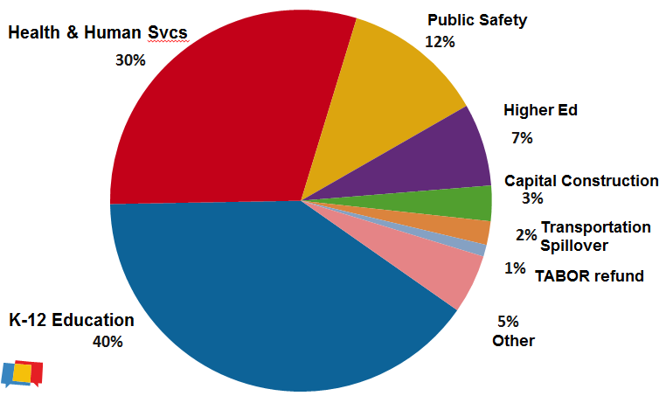
Where Do We Spend Our Money?
TOTAL STATE BUDGET = $11.3 billion
Notes:
First, let’s very quickly review the primary state spending areas. What are the big things we pay for that are funded from the General Fund and not paid from fees:
K-12 Education (40%) – This is the biggest part of the state budget and funding is mandated by Amendment 23 in our constitution.
Health and Human Services (30%) – includes things like Medicaid for the elderly & disabled, foster care, youth corrections, mental health facilities and other services.
Public Safety, Courts and Prisons (12%) – 21K prisoners @ $53 per day adds up.
Higher Education (7%) - State funding for Higher Ed has been reduced by 2/3rds over the last 20 years because … well, because we CAN. Unlike K-12, there is no constitutional mandate to fund Higher Ed.
Capital Construction (3%) – Public buildings like colleges and prisons etc. Most highway funding is from taxes we pay at the pump but when our economy is doing well as it is now we have statutory triggers that push General Fund into this spending area.
That’s it! That’s what Colorado spends its money on.

Slide 18
So, what’s the problem?
3 Reasons Why Our Fiscal Situation “Unsustainable”
Demographics - “Baby Boomers” are now “Seniors”.
The increasing costs of providing state services like health care for elderly and other vulnerable populations.
Conflicting fiscal rules that we’ve embedded into our constitution.
Notes:
So what is the problem? Why is this situation “unsustainable?”
Three overarching reasons:
Demographics – the changing population mixture of who we serve especially for Health Care (Medicaid) services
increasing cost of providing state services and
the rules we ourselves created and approved over the past 30 plus years now embedded in our state constitution.
Could Colorado muddle through one or two of these challenges? Maybe, but not all of them combined.

Slide 19
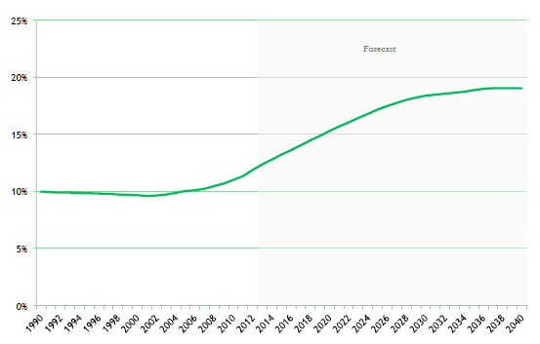
“UNSUSTAINABLE” REASON #1:
Demographics - “Baby Boomers” are now “Seniors”.
Colorado 65+ Population portion of total, 1990-2040
Source: Colorado State Demography Office
Notes:
Demographics – we have a population that is getting older and this slide shows that. We are aging and living longer than before and that really drives up health care costs.

Slide 20
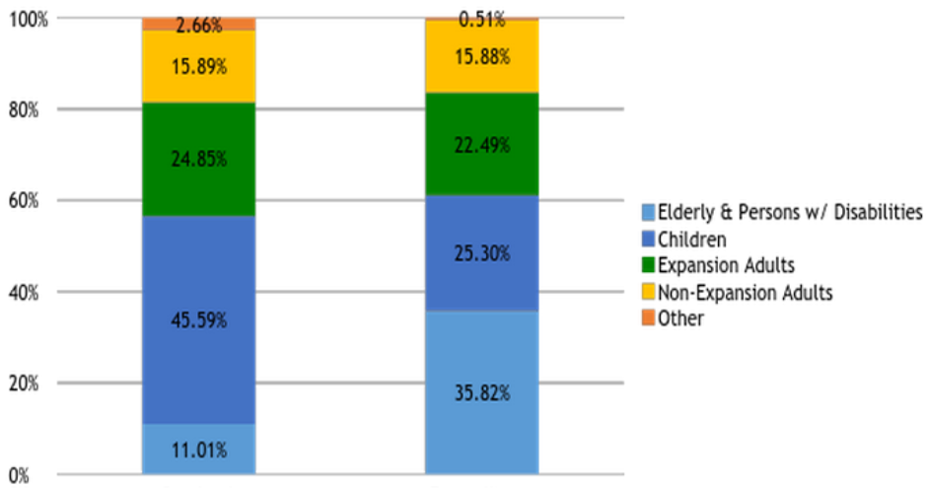
“UNSUSTAINABLE” REASON #2:
Medicaid Costs for Elderly & Disabled are Highest
Caseload
Expenditures
Notes:
This slide compares Medicaid cost to Medicaid population. It is not surprising that caring for elderly and disabled costs much more than caring for children or adults and here we see the most costly population is the one that is growing the fastest.
Although the Elderly and Disabled make up only 11% of the Medicaid population, we spend 36% of the Medicaid budget to care for this population.
Keep in mind that states are required by law to serve the Medicaid population as they define eligibility criteria within federal minimum standards, and the federal government provides matching funds.

Slide 21
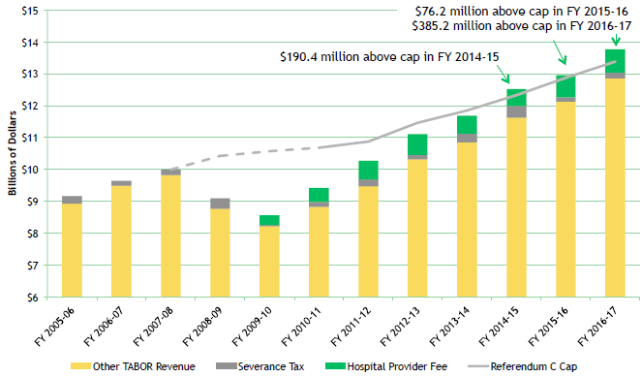
“Unsustainable” Constitutional Fiscal Rule #1:
TABOR continually decreases state revenues relative to the size of the economy because the economy grows faster than the TABOR limit.
Notes:
The economy has substantially recovered since the great recession and yes, Colorado’s job growth and economy as a whole has recovered faster than the rest of the country. This has resulted in a rebound in General Fund revenues but the third constitutional measure TABOR prevents state services like Medicaid and K-12 from benefiting from the recovery or even keeping up with costs.
This chart shows the increase in revenue that Colorado has experienced but it also shows that we are now creeping over the TABOR revenue line where we need to start refunding money even as we reduce state services.
TABOR limits state revenues to grow no faster than INFLATION (as measured by the Consumer Price Index) x POPULATION.
So what’s the problem? Well, the Consumer Price Index measures the growth in the cost of CONSUMER goods, like toasters, whereas government spends its money on things like construction materials and the salaries of teachers and corrections officers which grow at a rate faster than the cost of toasters. Over time, TABOR results in continually shrinking state revenues relative to the size of the economy.

Slide 22
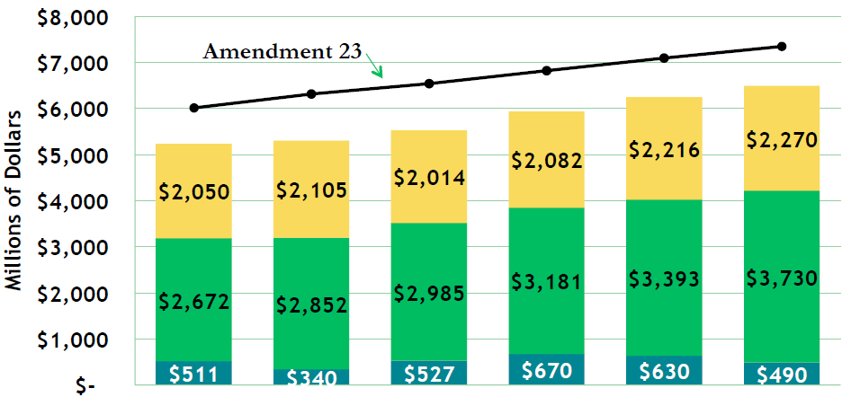
“Unsustainable” Constitutional Fiscal Rule #2:
Amendment 23 requires increased funding for K-12 education, even during economic downturns.
Reinterpretation of A23 reduced K-12 funding by $850M/yr.
FY
2011-12
FY
2012-13
FY
2013-14
FY
2014-15
FY
2015-16
FY
2016-17
Local Property Taxes & State Lands
State General Fund
State Education Fund
Notes:
Since 2000, Amendment 23 mandates a specific level of state spending on K-12 education. Amendment 23 requires us to increase spending on the largest part of the state budget by a factor equal to pupil headcount x inflation. Seems reasonable in theory, but tough to manage because this increased spending requirement continues during economic downturns.
In the dark days of the great recession, when every other program was being cut, the state reinterpreted the language of Amendment 23 in order to spend less on K-12 education and keep other critical programs afloat; this is the complicated sounding “negative factor.” All you need to know is that this reinterpretation of Amendment 23 allowed the state to balance the budget, but it reduced K-12 Education funding by about $850M, and this is being challenged in court.

Slide 23
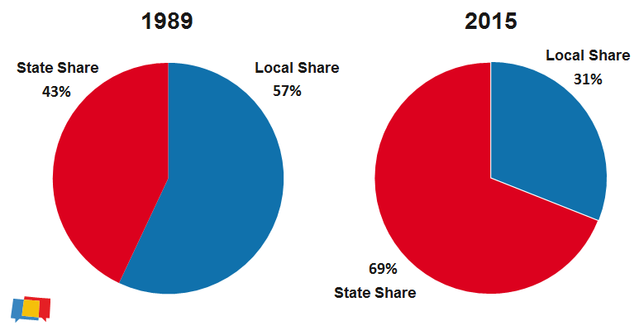
“Unsustainable” Constitutional Fiscal Rule #3:
The Gallagher Amendment has resulted in continually shifting
the K-12 funding cost from local to state government,
which causes the K-12 “slice” of the state budget to grow every year.

Slide 24
Findings from the Legislative-Commissioned DU Study on Colorado’s Economic Future, 2011-2024
Annual expected growth rates:
K-12 education expenditures = 6%
Medicaid expenditures = 8%
General Fund revenues = 5%
BOTTOM LINE:
“Even a strong recovery and sustained job growth over the next decade and a half will not produce enough income and sales tax revenue to afford Colorado’s share of Medicaid funding and the state’s payment for public schools under current constitutional and statutory provisions.”
“By fiscal year 2024 a structural imbalance in the state budget would result in only enough revenue to support Medicaid, K-12 education, and corrections. “

Slide 25
We believe Colorado can do better.

Slide 26
Thanks for your time!
Reeves Brown, BBCO Project Coordinator
reeves@betterco.org

