Slide 1
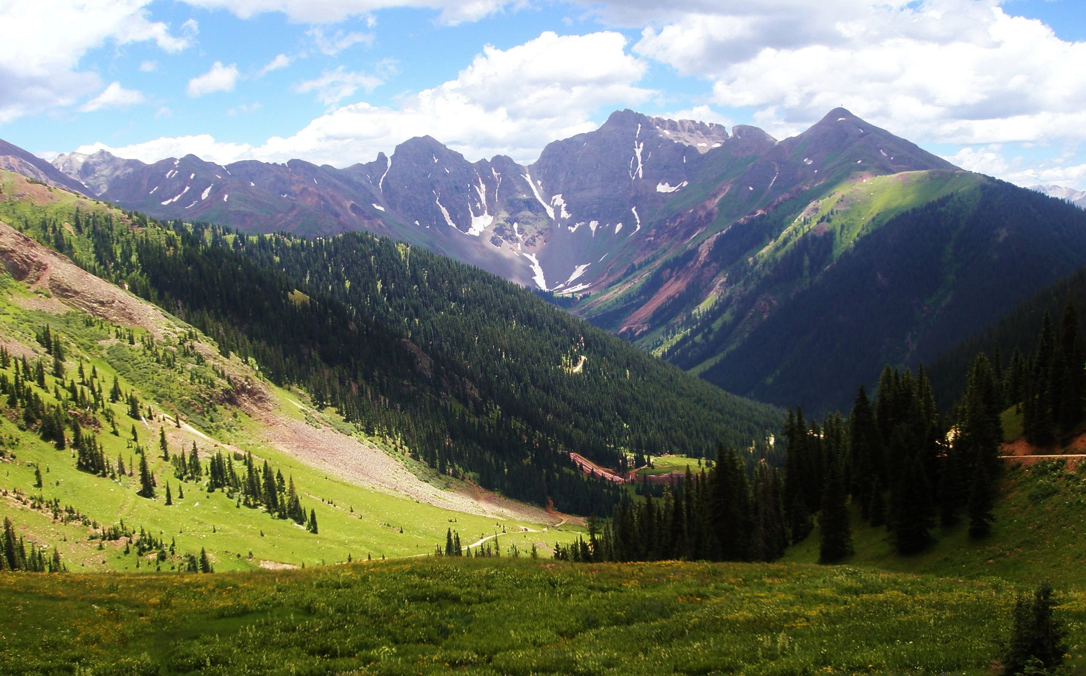
Colorado Economic Update
Colorado Association of Ski Towns – March 2015 Meeting
Ben Mendenhall – COLOTRUST

Slide 2
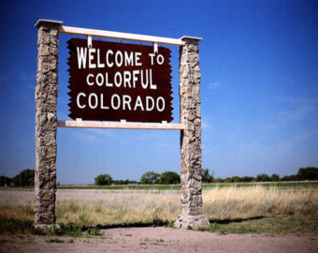
Presentation Overview
2014 Review
Regional Economic Update
2015 Forecast
Questions

Slide 3
2014 Review
The Colorado economy grew at a rapid pace in 2014
3rd highest growth rate since 2012 behind Texas and North Dakota¹
100.4% above the 2008 peak job growth figures²
January 2014 unemployment rate = 6.1%
November 2014 unemployment rate = 4.1%
Largest industry employment increases include: Mining, Professional & Technical Services, and Management of Companies & Enterprises.
Average sales tax revenue increased 5-7% statewide
1 Source - Federal Reserve Bank of Philadelphia
2 Source – www.Colorado.gov

Slide 4
2014 Review
The Colorado economy grew at a rapid pace in 2014
Per Capita income grew to $48,856¹
$2,508 above the national average
Still too low compared to cost of living gap
Population growth was expected to be 1.6% in 2014²
Jury is still out but estimates are it was higher
Denver-Boulder-Greeley CPI increased 2.8%²
Higher housing costs
Lower gas prices will help decrease inflation
1 Source - Department of Local Affairs State Demongraphy Office - Winter 2014
2 Source – DOLA State Demography Office – Winter 2014

Slide 5
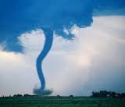
Regional Economic Update
Northeast Colorado
Many governments still recovering from the flood
Mostly flat sales tax revenues
Federal funding is now starting to come in
Housing prices are on the rise
Weld County had one of the highest job growth rates
Natural gas pipelines are starting to develop
Looking to add more renewable energy infrastructure.
Dependent on technological advances

Slide 6
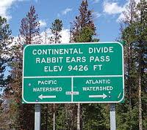
Regional Economic Update
Northwest Colorado
Experienced higher than average growth
Kremmling was up 15% in sales tax revenue
Steamboat Springs was above state average in sales tax revenue
Rio Blanco County is starting to struggle
Oil and gas production down 25% in Piceance Basin
Despite unemployment, seeing a slight increase in pop.
Moffat County experienced increased amounts of big game hunters
Craig’s sales tax revenue was higher than state average
Increased lodging tax revenues

Slide 7
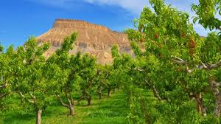
Regional Economic Update
Western Slope
Mesa & Delta Counties are facing challenges
Flat sales tax revenues
Property tax expected to stay flat
Meadow Gold is leaving
Major coal mine is shutting down
Looking for alternative revenue sources
Rafting, ATV’s, Dirt Bikes, Extreme Sports etc…
Great year for the Palisade area regarding agriculture
Wine, peaches etc…
Property tax valuations expected to increase
Montrose County is saving grace
City of Montrose did better than neighbors
Increase in businesses

Slide 8
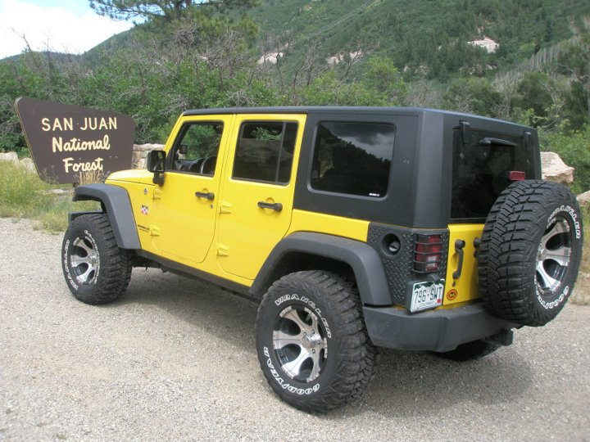
Regional Economic Update
San Juan/Four Corners Region
Sales tax revenues up above state average
Ouray, Ridgway, Telluride, Dolores all growing
Telluride & Cortez experienced high level of tourism
Lodging taxes were really high
Property tax valuations expected to increase
Durango experienced higher than average population, sales tax, and lodging tax growth
Many special districts passed mill levy increases
Pagosa Springs has recovered from the 2013 fire
Sales tax revenues and tourism are up

Slide 9
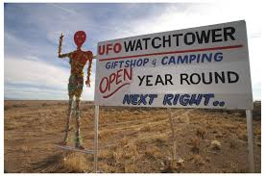
Regional Economic Update
San Luis Valley
Alamosa, Rio Grande, Conejos Counties improving
Steady population growth and new businesses
Discretionary income is still low
Some school districts receiving BEST grants
Barely making ends meet at new facilities
Sales tax revenues below state average but still in the black
Increased moisture but still seeing draught conditions
Property tax valuations expected to increase in 2015

Slide 10
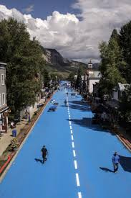
Regional Economic Update
Central Mountains
Gunnison, Chaffee, Park Counties are improving
Salida experienced higher than average sales tax revenues
Gunnison received a new tractor supply company
Crested Butte sales tax is above state average
Bud Light event boosted revenues
Park County experienced higher than usual tourism
New community events & concerts helped revenues
Summer recreational activities and events were up
Property tax valuations expected to increase in 2015

Slide 11
Regional Economic Update
Southeast Colorado
Economically depressed area of the state
Trinidad cannot lure businesses in
Population is decreasing
School district enrollments are way down
Higher than average moisture
Wheat production was up from 2013
Draught conditions improved
Pueblo area is stagnant
Cannot lure in businesses
Minor increase in property tax valuations expected in 2015
Wind Farms are starting to explore Prowers & Baca Counties
Could be a positive indicator for area

Slide 12
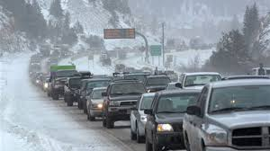
Regional Economic Update
I-70 Corridor
Above average sales tax revenues
Budgets have increased
Cannabis
Increased population
Short term workers influx
Property tax valuations expected to increase
Roaring Fork Valley home prices increasing
Inflated housing costs
Rental rates are way up
Traffic is affecting everyone
Record vehicles through the twin tunnels through December
Idaho Springs tunnel project FINALLY complete

Slide 13
Regional Economic Update
Front Range
Above average sales tax revenues
Budgets have increased
Cannabis revolution
Increased population
Denver is “the place to be”
Diverse Industry
Healthcare, Financial Services, Aerospace & Defense, Oil & Gas, Accounting etc…
Traffic is affecting everyone
Infrastructure cannot support growth
One of the most traffic congested metro areas in the country
Skyrocketing Housing Prices
Record rental rates in metro area
98% occupancies
Highest home prices in Denver history

Slide 14
2015 Forecast
FOMC expected to raise the Fed Funds rate by end of year.
General fund revenue (state) is expected to grow 8.8% in FY-14-15¹
Weakened Oil & Gas production might affect 2015 economy.
Higher than state average unemployment in Pueblo, Grand Junction, CO Springs, Western Slope.
Higher housing costs expected to continue.
Property tax valuations expected to increase 6-8% statewide.
Personal income expected to grow 5.9%².
Per-Capita income expected to increase to $50,915.
1 Source - Office of State Planning & Budgeting December 14
2 Source – OSPB December 2014

Slide 15
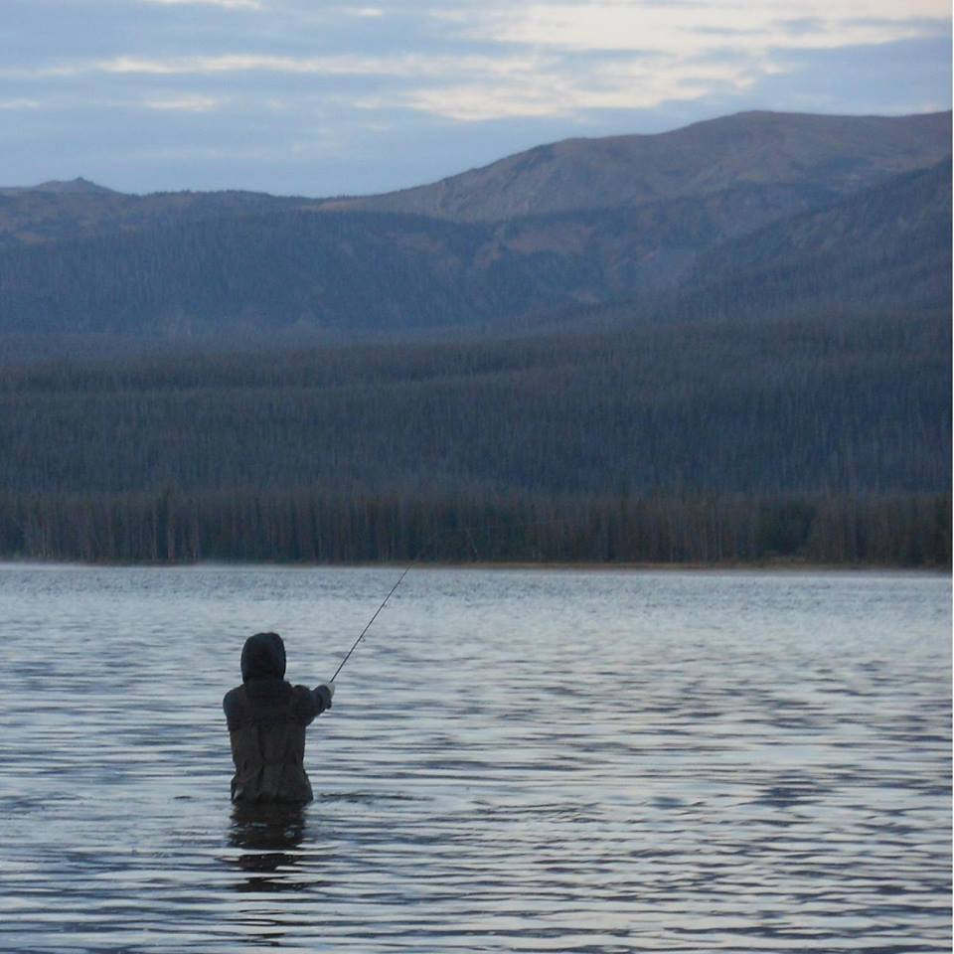
Questions & Comments

Slide 16
Additional Disclosure
This presentation is for informational purposes only. All information is assumed to be correct but the accuracy has not been confirmed and therefore is not guaranteed to be correct. Information is obtained from third party sources that may or may not be verified. The information presented should not be used in making any investment decisions. The presentation is not a recommendation to buy, sell, implement or change any securities or investment strategy, function or process. Any financial and/or investment decision should be made only after considerable research, consideration and involvement with an experienced professional engaged for the specific purpose. All comments and discussion presented are purely based on opinion and assumptions, not fact, and these assumptions may or may not be correct based on foreseen and unforeseen events. All calculations and results presented and are for discussion purposes only and should not be used for making and calculations and/or decisions. Performance comparisons will be affected by changes in interest rates. Investment returns fluctuate due to changes in market conditions. No assurance can be given that the performance objectives of a given strategy will be achieved. Past Performance is no guarantee of future results. Any financial and / or investment decision may incur losses.

